Slide 1
How to use this template
Make a copy of this deck (File > Make a copy) and adapt it to your company colors, logo, and design assets.
Then fill in the [bracketed text] with insights, data, KPIs, and information relevant to your company. Duplicate slides as needed to customize each section of the deck to your company and industry’s needs.
This pitch deck is your chance to look strategic and forward thinking in front of leadership, be bold on your projected business outcomes and don’t skimp on the change management!

Slide 2
Augmenting
[insert your team]
with AI
MONTH XX, 2025

Slide 3

THE OPPORTUNITY
[Company team]
has a significant opportunity to improve efficiency + output with AI

Slide 4
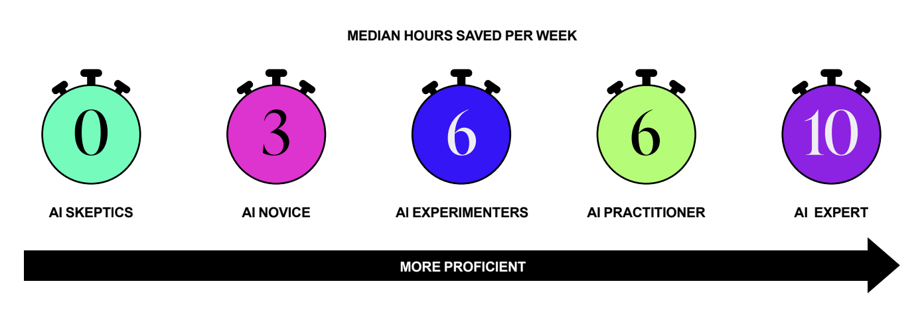
Desk workers with strong AI proficiency save over a day every week using AI
WHAT THE DATA SHOWS
Source: Section’s AI Proficiency Report

Slide 5



Productivity gains are happening across roles
WHAT THE DATA SHOWS
30-50%
25%
40%
ENGINEERS
STRATEGISTS
WRITERS
Source: McKinsey, June 2023; HBS, Wharton, BCG, August 2023.; Experimental evidence on the productivity effects of gen AI, July 2023.

Slide 6
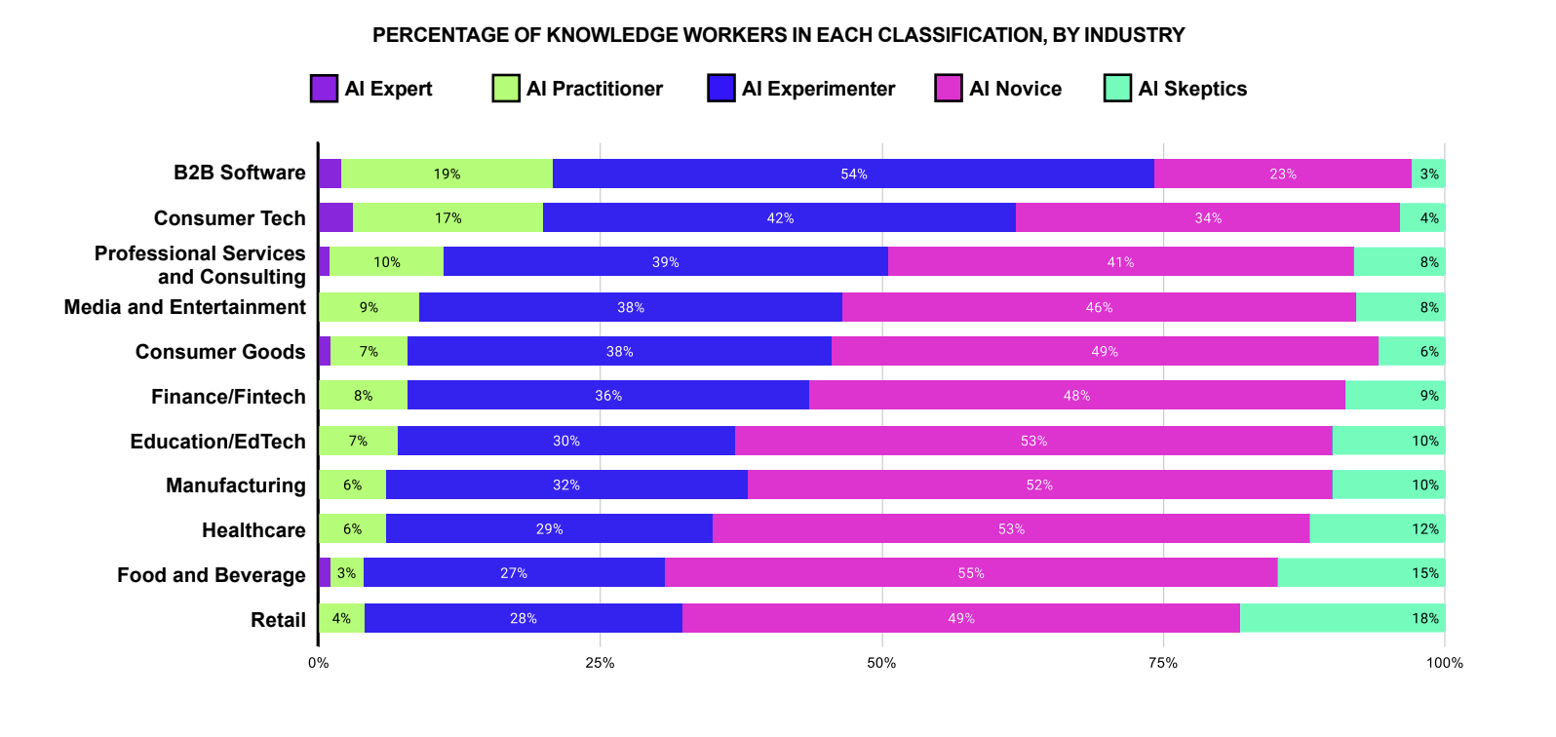
[Our industry] is [insert commentary on what the data shows].
Hint: If your industry is ahead, you need to catch up. If your industry is behind, you can create a powerful advantage by getting ahead.
WHAT THE DATA SHOWS
Source: Section’s AI Proficiency Report

Slide 7
Our 2025 goals as a team
[Goal 1] (e.g. Increase user conversion by creating a more smooth and delightful website experience)
Goal 1
[Goal 2] (e.g. Expand brand awareness with more timely thought leadership content)
Goal 2
[Goal 3] (e.g. Increase brand loyalty and retention by developing content that speaks directly to users)
Goal 3

Slide 8
Generative AI’s superpowers
Analyze content (text, code, images, video, files)
1
Generate ideas
2
Use Cases: Thought partner | Brainstorming
Use Cases: Content moderation I Summarizing I Analyzing data
Generate content (text, code, images, video)
3
4
Give feedback
Use Cases: Copywriting | Media Assets | Translations
Use Cases: Customer service | Tutors | Coaches

Slide 9
How AI could optimize workflows that support our goals
Generate content (text, image, video, or code) | Analyze content (text, image, video, or code) | Generate ideas | Give feedback
<List workflows here> | <List workflows here> | <List workflows here> | <List workflows here>

Slide 10
Where we should focus
LIST LOW-RISK, HIGH ROI PROJECTS HERE
High ROI
LIST HIGH-RISK, HIGH-ROI PROJECTS HERE
Slow to measure impact
Fast to measure impact
LIST HIGH-RISK LOW-ROI PROJECTS HERE
LIST LOW-RISK, LOW-ROI PROJECTS HERE
Low ROI
Notes:
The money shot - top right - probably focus here first, if you had any ideas that you plotted here

Slide 11
Three projects to prioritize in 2025
RECOMMENDATION
1
2
3
Insert project 1
(Ex: Outsource first drafts of social posts to AI)
Insert goal it supports
Insert project 2
(Ex: Implement chatbot on marketing site)
Insert goal it supports
Insert project 3
(Ex: Conduct persona research using AI)
Insert goal it supports

Slide 12
We will achieve [business outcomes] in [time frame] in the following way:
IMPLEMENTATION TIMELINE & MILESTONES
[Milestone 1 – e.g. “Roll out ChatGPT access”]
Week 1
[Milestone 2 – e.g. “Provide team level training”]
Weeks 2-4
[Milestone 3 – e.g. “Build, test, and iterate on first Custom GPT”]
Weeks 4-6
[Milestone 4 – e.g. “Finish workflow mapping and begin AI augmentation”]
Weeks 6-8
[Milestone 5 – e.g. “Finalize Custom GPT creation and launch AI augmented workflows”]
Weeks 8-10

Slide 13
To achieve these results, we will need to make the following investments:
BUDGET RECOMMENDATION
[e.g. “A ChatGPT for Teams subscription for 100 employees: $30 per user × 100 users = $3,000 per month.]
Investment 1
[e.g. “Practical training for 100 employees: $30,000 per year for unlimited access to Section.]
Investment 2
[e.g. “Optional: Workforce transformation consultation or workflow redesign consultation: $15,000 with Section]
Investment 3

Slide 14
Here are the metrics we’ll be tracking to prove ROI in the next 24-36 months:
MEASURING IMPACT & ROI
[e.g. “A 20% increase in output in language intensive functions like marketing, sales, and customer success.”
Metric 1
[e.g. “A 10% increase in number of new products successfully launched without hiring more staff.”]
Metric 2
[e.g. “A 10 point increase in customer NPS.”]
Metric 3

Slide 15
Here’s where we go from here:
NEXT STEPS
[Step 1 – e.g. “Drafting an AI manifesto that outlines guardrails and expectations.”]
Step 1
[Step 2 – e.g. “Choosing pilot teams to roll AI out to first.”]
Step 2
[Step 3 – e.g. “Designing an onboarding and training plan for the pilot team.”]
Step 3
[Step 4 – e.g. “Design a reporting process that allows up to track measurable improvements.”]
Step 4
[Step 5 – e.g. “Begin management training.”]
Step 5

Slide 16
Some free tools to help us get started:
HELPFUL RESOURCES
The Executive’s Guide to Generative AI eBook
Tool overview videos for major LLMs
Custom GPT workbook (to help kickoff internal automation)
AI Manifesto Creation Guide (to help set internal expectations)
Free workshop on 1 hour to AI proficiency
AI ROI Calculator (to measure qualitative & quantitative wins)

Slide 17











Section is your workforce transformation partner for the age of AI.
We work with teams to create AI strategies that actually get ROI – and help employees get AI proficient fast in hands-on courses taught by executives from companies like OpenAI, Meta, and Google. Here’s who we’re working with right now:
ABOUT SECTION
P.S. We can do everything we mentioned in this deck! Get a meeting with a member of our team to talk about benchmarking AI use in your company, getting seats to our AI academy, or booking a consultation.

